Slide 1
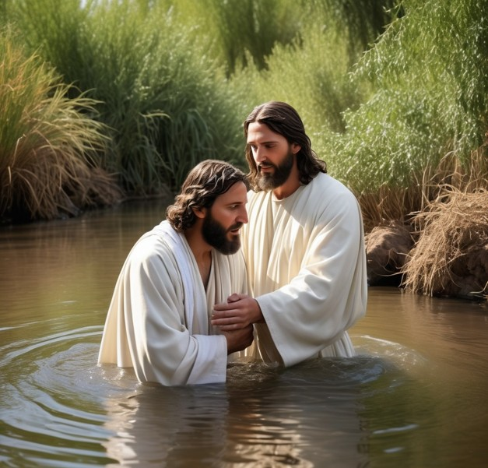
Key to Holiness (sanctification):
(Romans. 6:1-11)
1. Union with Christ - death
Dead to sin
Baptized into Christ’s death
Buried with Christ
Raised to newness of life
Old is crucified (Gal. 2:20)
No Longer enslaved to sin
We died and are set free from sin
Consider yourselves dead to sin, but alive to God in Christ

Slide 2

Key to Holiness: (Sanctification)
(Romans 6:12-23)
2. Obey your new Master:
Do not let sin reign
Yield yourself to God (a tool)
Live under grace
See yourself as an obedient slave of God, not of sin
Obey with all your heart
Freed from sin, slave of righteousness
A slave of God produces holiness, leading to God’s gift of everlasting life (all through Christ)
This Photo by Unknown Author is licensed under CC BY-NC

Slide 3
Paul
^{NKJ} 1 Corinthians 6:19 Or do you not know that your body is the temple of the Holy Spirit who is in you, whom you have from God, and you are not your own? ²⁰ For you were bought at a price; therefore glorify God in your body and in your spirit, which are God’s.
^{NAU} Romans 12:1 Therefore I urge you, brethren, by the mercies of God, to present your bodies a living and holy sacrifice, acceptable to God, which is your spiritual service of worship. And do not be conformed to this world, but be transformed by the renewing of your mind, so that you may prove what the will of God is, that which is good and acceptable and perfect.
Colossians 3:1-10
^{NKJ} Titus 2 ¹¹ For the grace of God that brings salvation has appeared to all men, ¹² teaching us that, denying ungodliness and worldly lusts, we should live soberly, righteously, and godly in the present age, ¹³ looking for the blessed hope and glorious appearing of our great God and Savior Jesus Christ, ¹⁴ who gave Himself for us, that He might redeem us from every lawless deed and purify for Himself His own special people, zealous for good works. ¹⁵ Speak these things, exhort, and rebuke with all authority

Slide 4
Luke & Peter
Watchful and faithful slaves (12:35–49; 17:7-10)
^{NAU} Acts 2:18 EVEN ON MY BONDSLAVES, BOTH MEN AND WOMEN, I WILL IN THOSE DAYS POUR FORTH OF MY SPIRIT And they shall prophesy.
^{NAU} Acts 4:29 "And ¹now, Lord, take note of their threats, and grant that Your bond-servants may speak Your word with all confidence,
^{NLT} 1 Peter 2:16 You are not slaves; you are free. But your freedom is not an excuse to do evil. You are free to live as God's slaves.
Peter, James, Jude introduce themselves as slaves of Christ

Slide 5
Scriptural Support: JESUS
^{NKJ} Matthew 16:24 Then Jesus said to His disciples, "If anyone desires to come after Me, let him deny himself, and take up his cross, and follow Me. (Mark 8:34; Luke 9:23)
^{NKJ} Matthew 10:38 "And he who does not take his cross and follow after Me is not worthy of Me. ³⁹ "He who finds his life will lose it, and he who loses his life for My sake will find it.
^{NKJ} John 12:25 "He who loves his life will lose it, and he who hates his life in this world will keep it for eternal life. ²⁶ "If anyone serves Me, let him follow Me; and where I am, there My servant will be also. If anyone serves Me, him My Father will honor.
John 15:13-20 (a friend and a slave)

