Slide 1
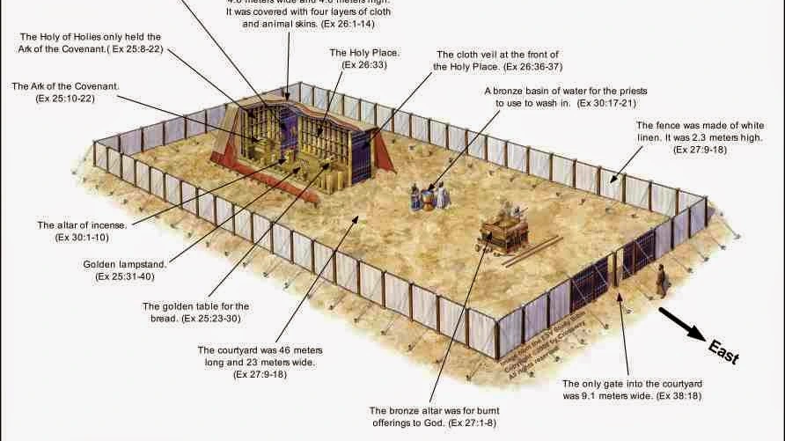

Slide 5
The pattern for intimacy with God
^{NKJ} Hebrews 12:14 Pursue peace with all people, and holiness, without which no one will see the Lord:
^{NKJ} Matthew 5:8 Blessed are the pure in heart, For they shall see God.
^{NKJ} Psalm 24:3 Who may ascend into the hill of the LORD? Or who may stand in His holy place? 4 He who has clean hands and a pure heart, Who has not lifted up his soul to an idol, Nor sworn deceitfully.
^{NKJ} Revelation 19:7 "Let us be glad and rejoice and give Him glory, for the marriage of the Lamb has come, and His wife has made herself ready."8 And to her it was granted to be arrayed in fine linen, clean and bright, for the fine linen is the righteous acts of the saints.

Slide 6
The tabernacle(Ex. 25-40) - where one communes with God
A picture of how to have intimacy with God – the way of holiness into the presence of God
Jesus is revealed in the Old Testament – probably in no better a picture than the tabernacle
^{YLT} John 1:14 And the Word became flesh, and did tabernacle among us, and we beheld his glory, glory as of an only begotten of a father, full of grace and truth.
^{NKJ} Exodus 25:8 "And let them make Me a sanctuary, that I may dwell among them.
^{NKJ} Exodus 25:22 "And there I will meet with you, and I will speak with you from above the mercy seat, from between the two cherubim which are on the ark of the Testimony, about everything which I will give you in commandment to the children of Israel.

Slide 7
The door
The narrow way into righteousness – only through Christ our righteousness
“I am the way” John 14:6 – no one gets to God except through Jesus
“I am the door” – John 10:9 – if anyone enters through Me, he will be saved
The moment one chooses to leave the world and enter into a relationship with God through Jesus, they must leave the world, enter through the narrow gate, and then are immediately faced with the Lamb of God sacrificed for their sins, giving them access to continue into the presence of God

Slide 8
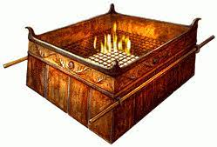
Brazen Altar (The Cross) - deal with sin first - unholy cannot enter into the presence of Holiness
First step on the way to the presence of God, is to deal with the sin issue
The lamb slain – a male without defect, fastened to the horns of the altar, facing the fires (hot coals) of judgment
^{NKJ} Hebrews 9:22 And according to the law almost all things are purified with blood, and without shedding of blood there is no remission (forgiveness). “He was pierced for our transgressions”
(Read chapter 9 of Hebrews)

Slide 9
The bronze laver – washing away the dirt of being in the world – no dimensions, or limitations
“Clean hands and a pure heart”
Represents the washing by the word – a mirror (Ex. 38:8) that you look into to see your own filthiness (James 1:22-25)
Washing of the word: Titus 3:5; Heb. 4:12; Eph. 5:26
John 13:8-10
Many stop after the cross – don’t allow the word to daily purify and cleanse them – no intimacy with God

Slide 10
Table of showbread – out of one batch of flour – 12 loaves
Fellowship at the table only after the cleansing
Spiritually hungry want bread – feed on Christ to get close to God
Bread of life (John 6:35,63, 68) = feeding on Christ the living word
Matt. 4:4 – come to the table and eat with Jesus - fellowship
Twelve loaves represent family, communion (1Cor. 10:16-17)

Slide 11
Golden Lampstand (1John 1:5-7)
Continually lit – the light of the world (John 8:12)
The sevenfold spirit of God
The seven churches of Revelation
One central shaft with branches – the unity of Christ and believers – beaten one piece of pure gold – we shine through suffering (2Cor. 4:17)
Trim the wicks for more light (pruning)

Slide 12
The altar of incense – continual burning
Gold crown top, with horns of victory – His victory, in His Name, we can approach God in Prayer – abiding in Christ (bread and light) produces much fruit
Christ our Intercessor (Heb. 7:25; Rom. 8:34)
Prayers of the saints (Rev. 8:3-4; Luke 1:9-10)
Praying in the Holy Spirit (Eph. 6:18; Rom. 8:26-27)

Slide 13
The Ark of the covenant
Behind the veil – torn by the cross of Jesus
The mercy seat, the cherubim, the shekinah glory – the presence of God (Ex. 25:22)
Inside - The ten commands, the manna, Aaron’s rod – law, grace , choosing and blessing (Heb. 9:4)
We can boldly go into His presence (Heb. 10:19-32)

Slide 14
The Message of the tabernacle
There was a series of rituals that enabled the presence of God to inhabit His people, performed by a chosen priesthood.
The whole tabernacle revealed the work of Christ on our behalf and showed us the way into the presence of God
To “see” God, commune with Him, requires holiness (clean hands and a pure heart). The tabernacle layout is a great picture of how we might obtain and maintain the purity required to fellowship with God through Christ.
Christ has done all the work, and Father is waiting to commune with us; we decide how close we are going to get to Him. It is time for the bride to become intimate with her Lord!

